Slide 1
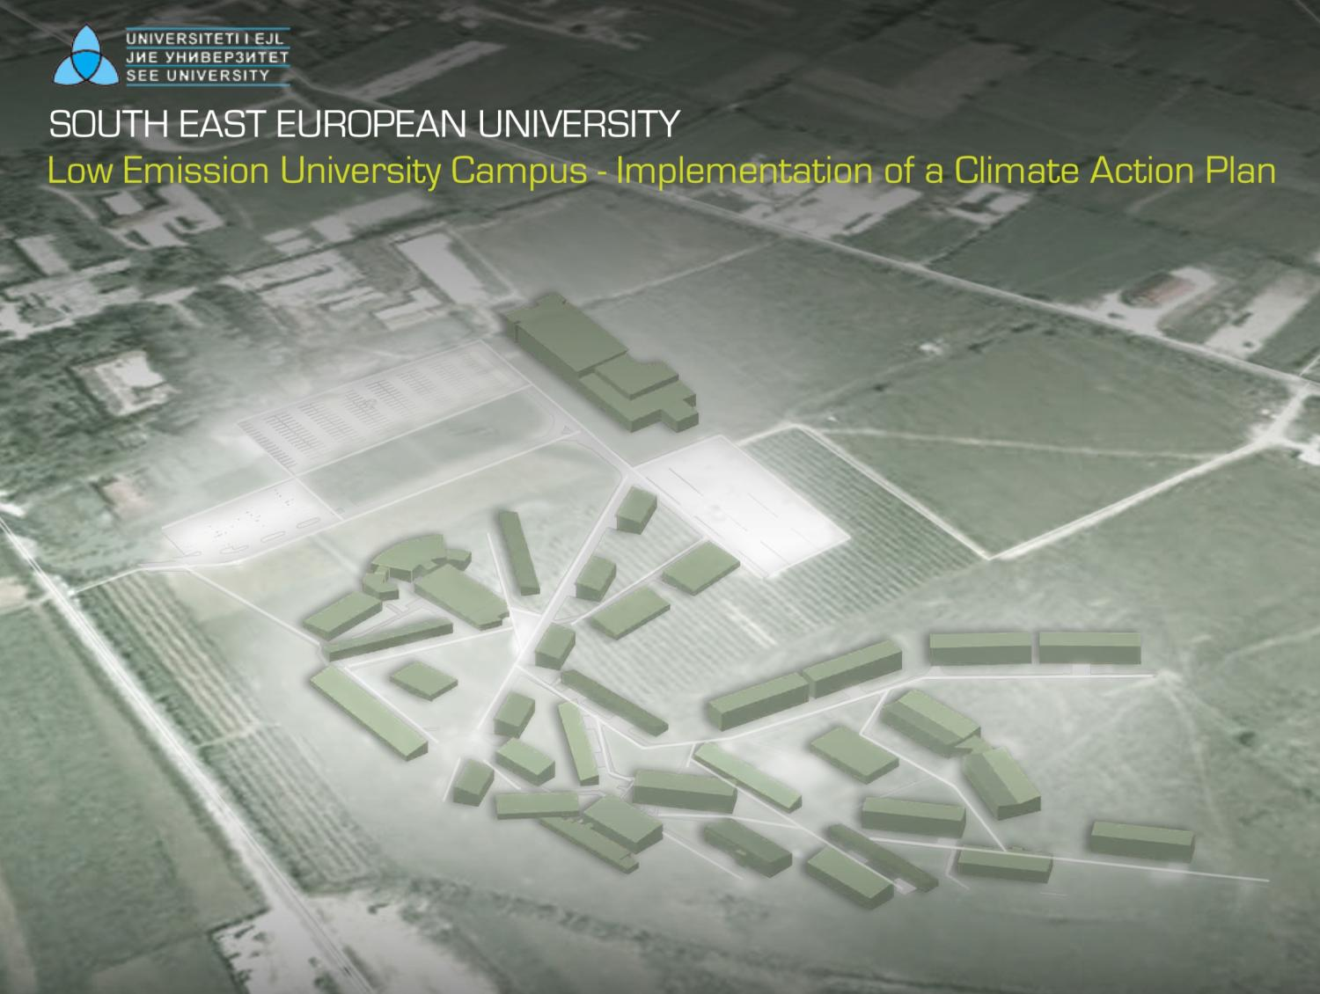
Tetovo, September 29th, 2011
Teaching a Sustainable Future

Slide 2
The Project Framework
March 2005: Memorandum of Understanding between the Macedonian Ministry of Environment and Physical Planning (MOEPP) and the Italian Ministry for the Environment, Land and Sea (IMELS) in the field of Environment and Sustainable Development. Goal is the implementation of priority actions to mitigate the impact of climate change in the Republic of Macedonia.
March 2010: due to the important role of Universities as large energy consumers and as educational institutions, the Authorities identified as a pilot initiative the transformation of SEEU into a Low Emission University Campus.

Slide 3
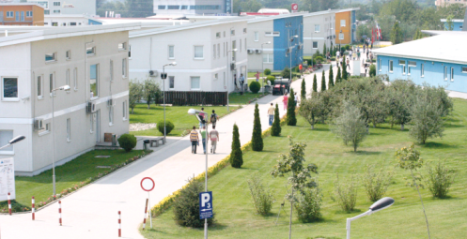
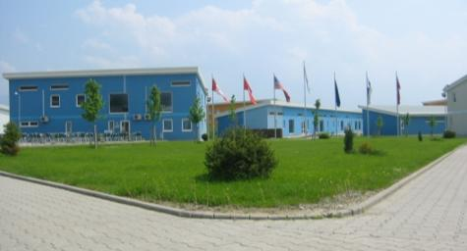
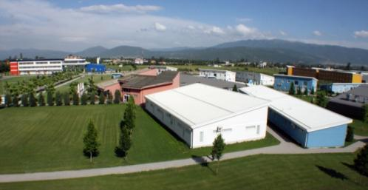

The University
The SEEU is a modern university campus in Tetovo, Macedonia.
Faculties of Law, of Business Administration, of Public Administration and Political Sciences, of Contemporary Sciences and Technologies, of Languages Cultures and Communications
6,000 enrolled students (450 lodged at the Campus) – year 2009
197,000 m² total surface – 29,000 m² net built surface

Slide 4
The Climate Action Plan – CAP
Following the high level commitments on climate change, several universities in the U.S.A. have undertaken plans to reduce their net emissions, in order to manage carbon emissions and energy more efficiently.
CAP is a roadmap to get SEEU to the goals of climate protection, defining carbon footprint, identifying priority actions and applicable technologies, milestones to measure progress and target dates, raising funding opportunities.

Slide 5
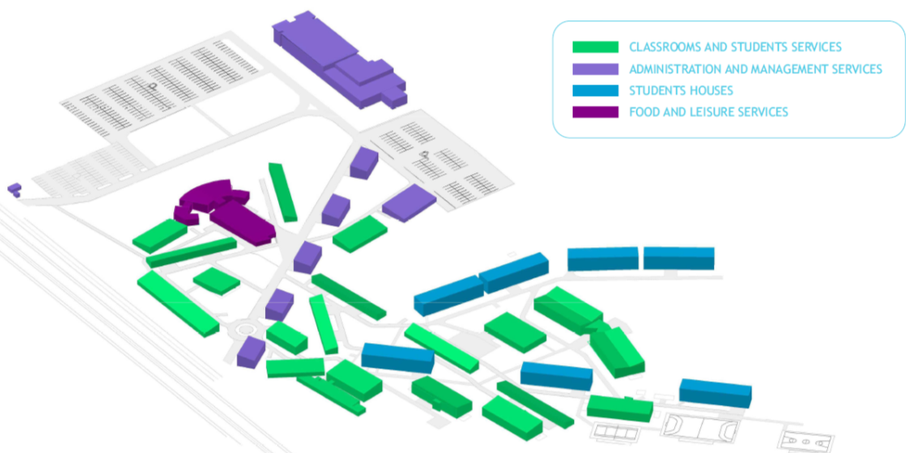
The Climate Action Plan – CAP
The project, launched on March 2010 and terminated on September 2011, was aimed at introducing high energy efficiency measures and renewable energy technologies in the South East European University in Tetovo, with the purpose of realizing a low emission campus through the implementation of a CAP.
The project is a donation of the Italian Ministry for the Environment, Land and Sea

Slide 6
The Climate Action Plan – CAP
Campus growth: services, students, facilities
Increasing energy demand for SEEU for operation
Rise in GHG emissions
CAP: powerful tool to set priorities in the pathway to carbon neutrality

Slide 7
The Climate Action Plan – CAP
Goals
Outline strategies and a timeline for reducing GHG emissions
Propose interim goals and actions for reducing GHG emissions
Support Sustainability
Identify mechanisms for tracking progress
Identify financing mechanisms
Promote education on Climate Change
Contents
GHG inventory
Assessment of emissions-reducing projects
Strategies
Plan for implementation

Slide 8

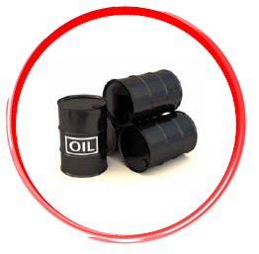

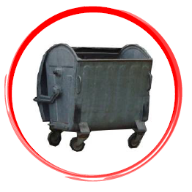






The GHG Inventory

Slide 9
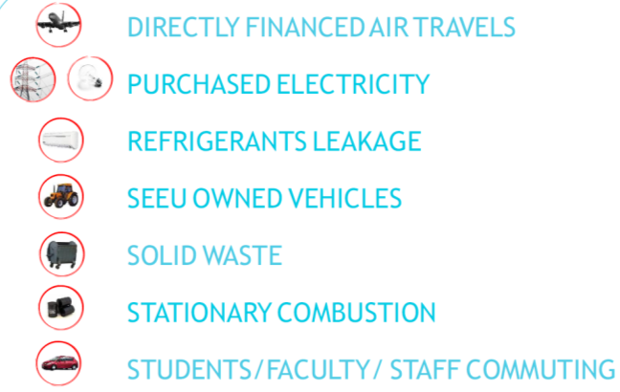
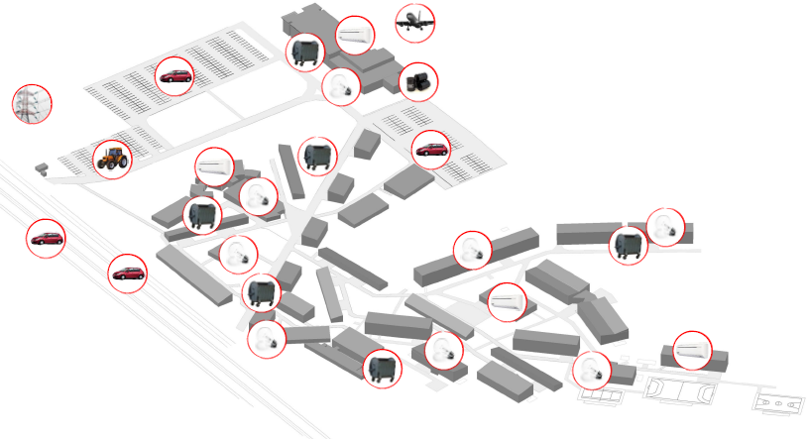
The GHG Inventory

Slide 10
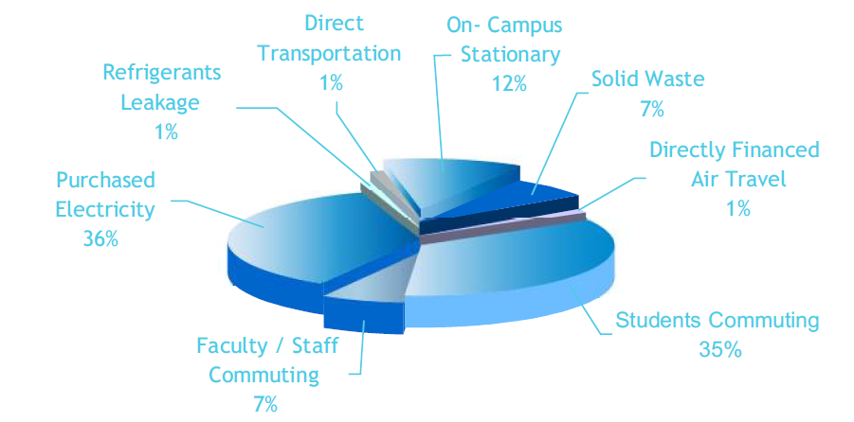
The GHG Inventory
Total Campus Emissions in Fiscal Year 2009: 5,100 tCO₂e

Slide 11



CAP Strategies
STUDENTS / FACULTY / STAFF COMMUTING
PROMOTION OF CARPOOLING – SUPPORT TO PUBLIC TRANSPORT STRATEGIES – SEEU SHUTTLES
Emission Reduction:
360 tCO₂e/y – 7.1% from carpooling
75.5 tCO₂e/y – 1.5% from SEEU Shuttles

Slide 12


CAP Strategies
DIRECTLY FINANCED AIR TRAVELS
USE OF VIDEOCONFERENCES
Emission Reduction: 33 tCO₂e/y – 0.7%

Slide 13



CAP Strategies
SOLAR PHOTOVOLTAIC
SOLAR THERMAL
POLICIES FOR BEHAVIOR MODIFICATION
PURCHASED ELECTRICITY
  Emission Reduction:
  217 tCO₂e/y – 4.3% from solar thermal
  545 tCO₂e/y – 10.7% from solar photovoltaic
  19.5 tCO₂e/y – 0.4% from behavior modification

Slide 14


CAP Strategies
CONVENTIONAL LAMPS
LAMPS REPLACEMENT:
USE OF EFFICIENT LAMPS
Emission Reduction: 220 tCO₂e/y – 4.3%

Slide 15
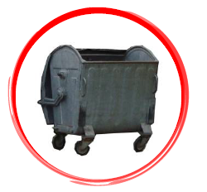

CAP Strategies
SOLID WASTE MANAGEMENT
PROMOTION OF RECYCLING
AND SELECTIVE COLLETION
  Emission Reduction: 2.8 tCO₂e/y – 0.1%

Slide 16
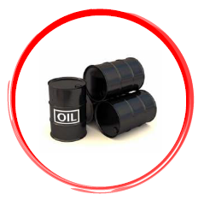

CAP Strategies
FUEL SWITCH TO LPG
USE OF BIOMASS
USE OF GEOTHERMAL
POLICIES FOR ENERGY EFFICIENCY
HEAVY FUEL COMBUSTION
  Emission Reduction: 170 tCO₂e/y – 3.4% of total emissions for LPG

Slide 17
Other CAP Strategies
  Foundations Insulation:
  Emission Reduction: 125 tCO₂e/y – 2.5% of total emissions
  University Fleet Upgrade:
  Future investments on more efficient and smaller vehicles
  Creation of a Green Fund: introduction of a fee per semester per student to finance student, faculty, and staff sustainability initiatives
  Carbon Offset:
  The Campus shall choose offset only once all the other sustainable options have been explored
  Verified Emission Reductions (VER) share: 10% of yearly emissions

Slide 18


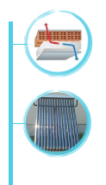
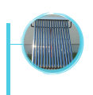
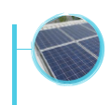




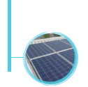
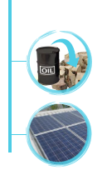

CAP Timeline
2011:
Policy for Behavior Modification
Videoconferences
SEEU Shuttles
Lamps Replacement
2012:
Photovoltaic Plant
Videoconferences
Public Transport Enhancement
Lamps Replacement
2020:
Fuel Switch
Photovoltaic Plant
2014:
Selective Waste Collection
Promotion of Carpooling
Public Transport Enhancement
2018-2019:
Photovoltaic Plant
2016-2017:
Solar Thermal Systems
Foundations Insulation
2013:
Public Transport Enhancement
Promotion of Carpooling
Photovoltaic Plant
2015:
Solar Thermal Systems

Slide 19
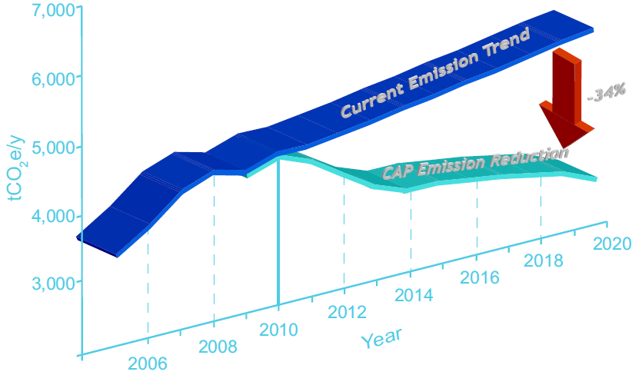
CAP Figures
35%
GHG emissions as of 2009: 5,100 tCO₂e per year
GHG emissions forecast in 2020: 3,400 tCO₂e per year
Emission Reduction: 35%
Cumulative Estimated Implementation Cost: 5 M€

Slide 20
The Sustainable Energy Building
Pilot Project in Building 304 – Institute for Environment and Health: Conversion of a traditional building into a Sustainable Energy Building:
Reduction of Energy Needs and Dispersions
Efficient Use of Energy
Electricity and Heat from Renewable Energy Sources to meet the Energy Demand
Technologies
Geothermal heat pump
Solar photovoltaic and solar thermal plant
Controlled mechanical ventilation
Solar blinds
Foundations insulation
Energy Performance Management System

Slide 21
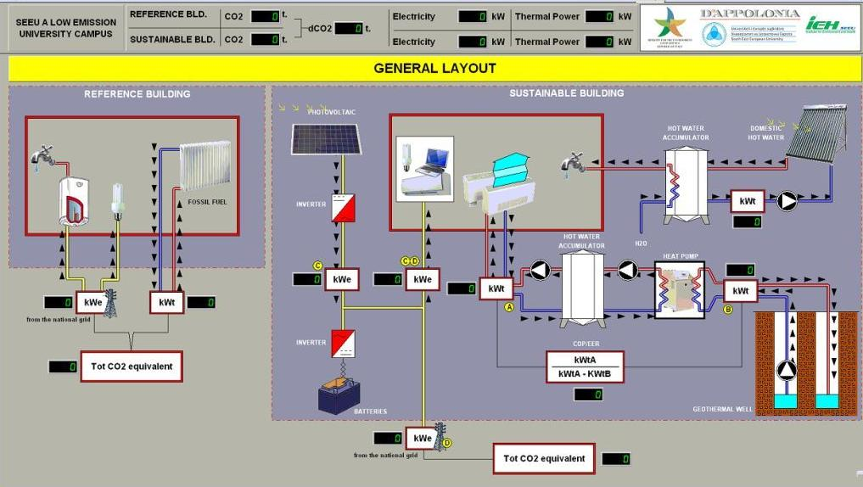
Energy Performance Management System

Slide 22
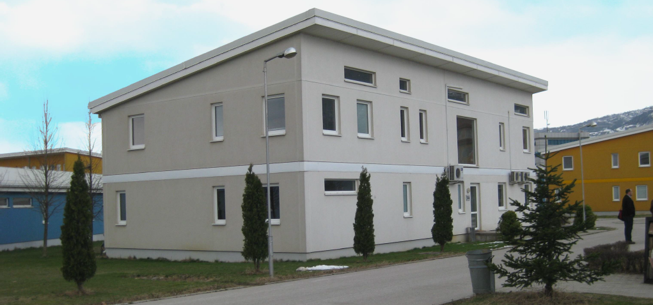
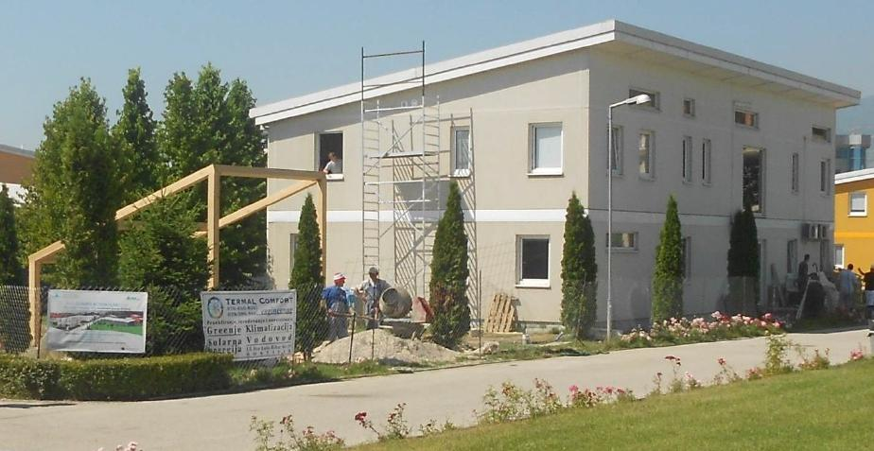
The Sustainable Energy Building

Slide 23
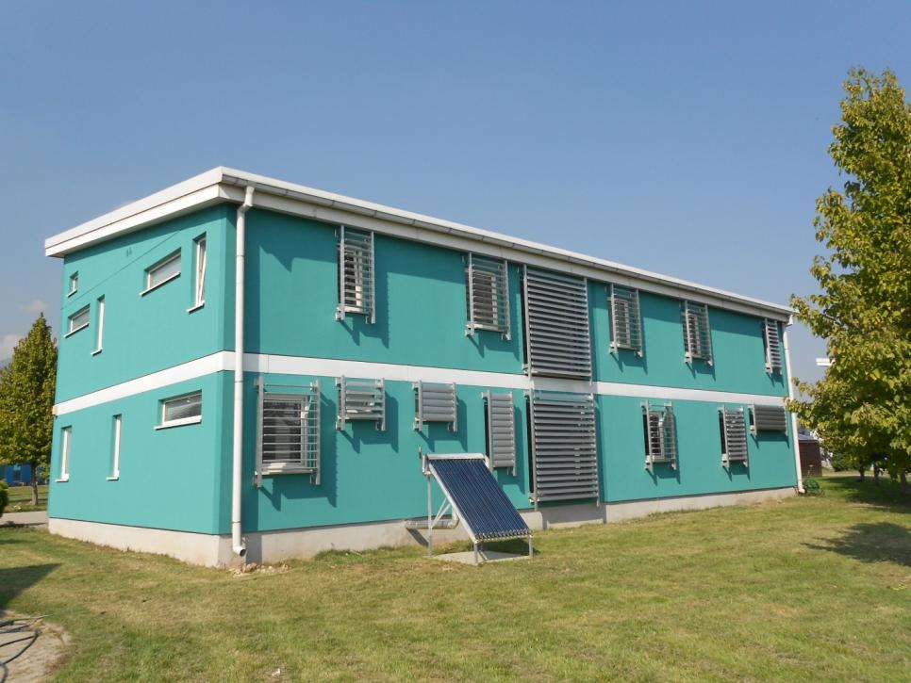
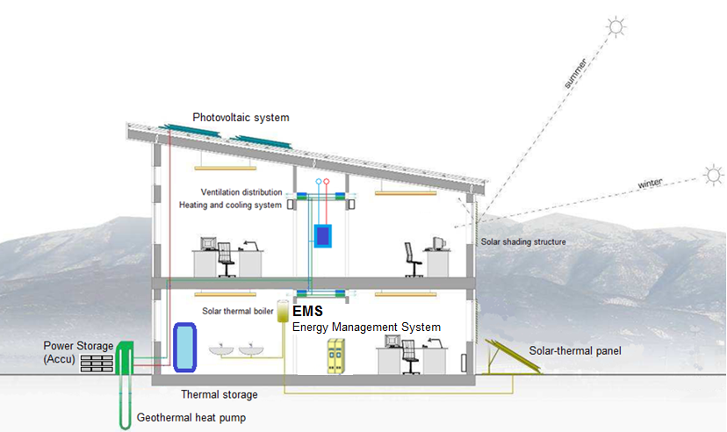
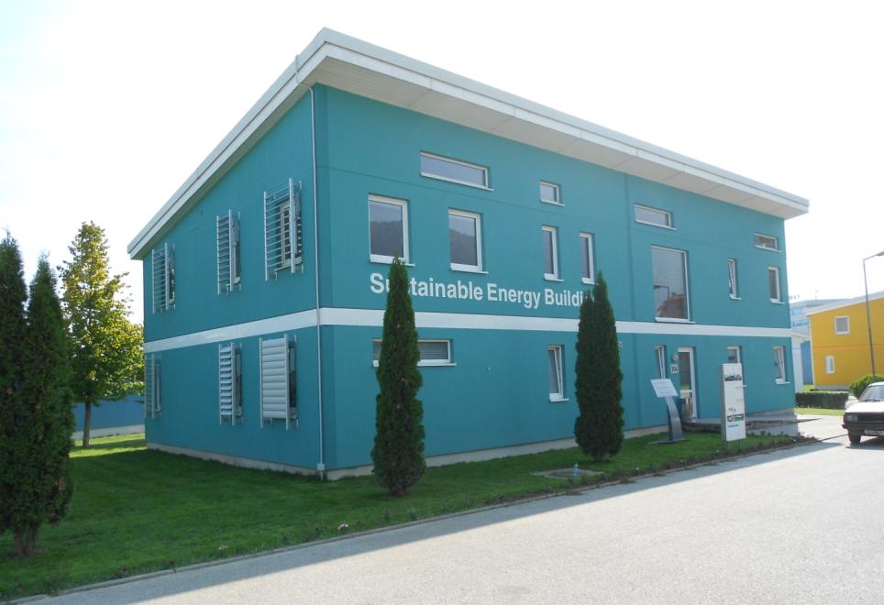
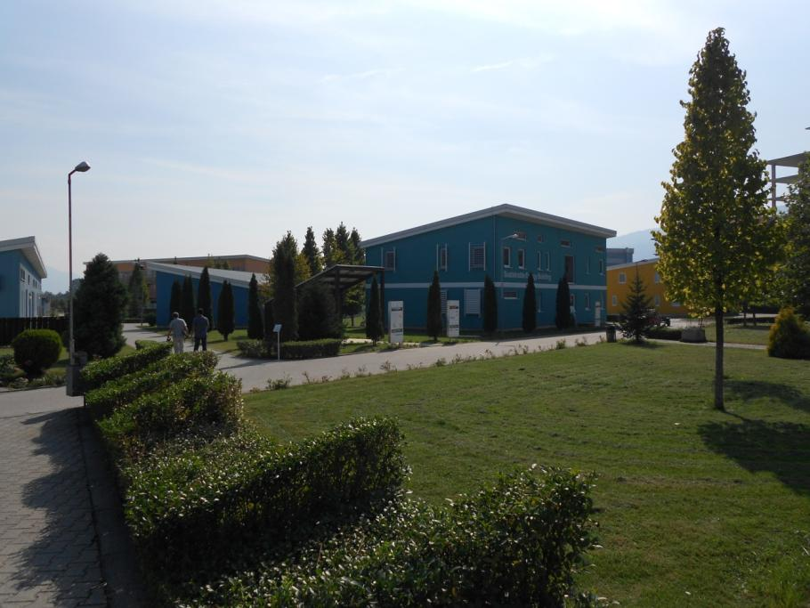
The Sustainable Energy Building

Slide 24
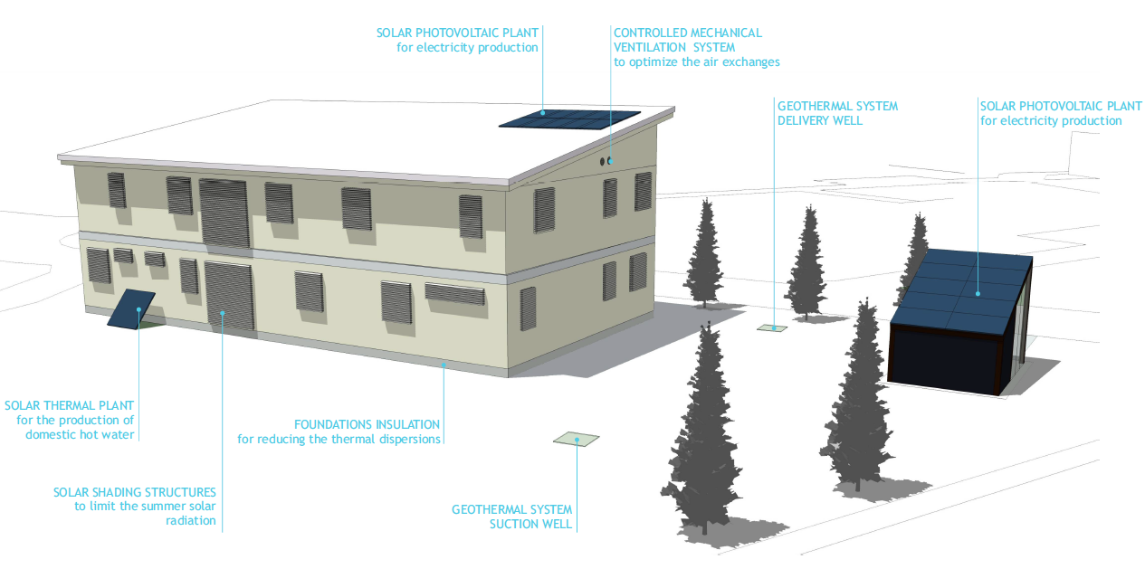
The Sustainable Energy Building
SOLAR PHOTOVOLTAIC PLANT
for electricity production
CONTROLLED MECHANICAL
VENTILATION SYSTEM
to optimize the air exchanges
GEOTHERMAL SYSTEM
DELIVERY WELL
SOLAR
PHOTOVOLTAIC
PLANT
SOLAR THERMAL
for domestic hot water production
FOUNDATIONS INSULATION
for thermal dispersions
SOLAR SHADING STRUCTURES
to limit the summer solar radiation
GEOTHERMAL SYSTEM
SUCTION WELL

Slide 25
CAP Figures
35%
GHG emissions as of 2009: 5,100 tCO₂e per year
GHG emissions forecast in 2020: 3,400 tCO₂e per year
Emission Reduction: 35%
Cumulative Estimated Implementation Cost: 5 M€

Slide 26
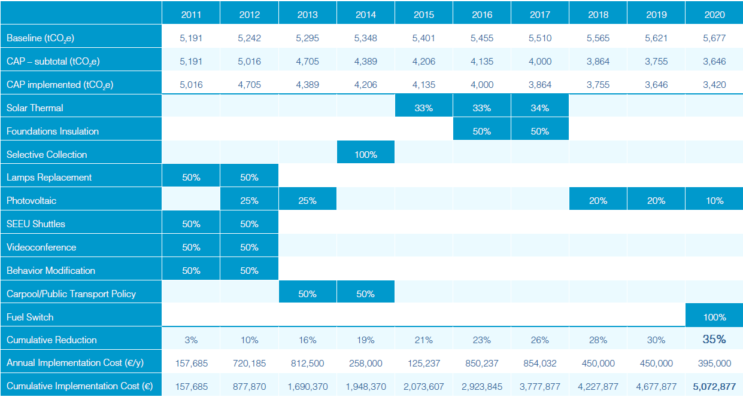
CAP Time Frame for Implementation
Medium-term
Short-term
Long-term

Slide 27
Sustainable Energy Campus
CAP
Sustainable Energy Strategy
Sustainable Energy Campus
SEEU Microgrid
Basic Elements of SEEU’s SES:
Enhancing the reliability and security of energy supply and PQ
Reducing the overall energy use
Using the energy more efficiently
Replacing non-renewable with renewable energy
Fuel switching to lower-carbon energy sources (biomass, biofuel, biogas, and methane)
Applying new technologies

Slide 28
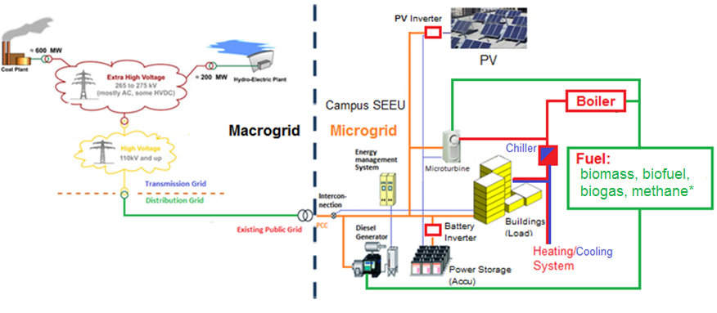
Macrogrid and SEEU Microgrid – Vision
SEEU small scale power supply network based on sustainable energy strategy. It also represents the SEEU Microgrid.

Slide 29
Faleminderit
Влагодариме за вниманието
Thank you for your attention
For further information please contact:
gianluca.cassulo@dappolonia.it
a.abazi@seeu.edu.mk

